Slide 1

AEROSPACE CHEMICALS and
LOGISTICS SOLUTIONS

Slide 2

WHO ARE WE?
WHAT DO WE DO?
WHY WE DO IT?
OUR ORGANIZATION

Slide 3
WHO ARE WE?
We are a team of people working in the BU dedicated, since 1951, to aerospace.

Slide 4
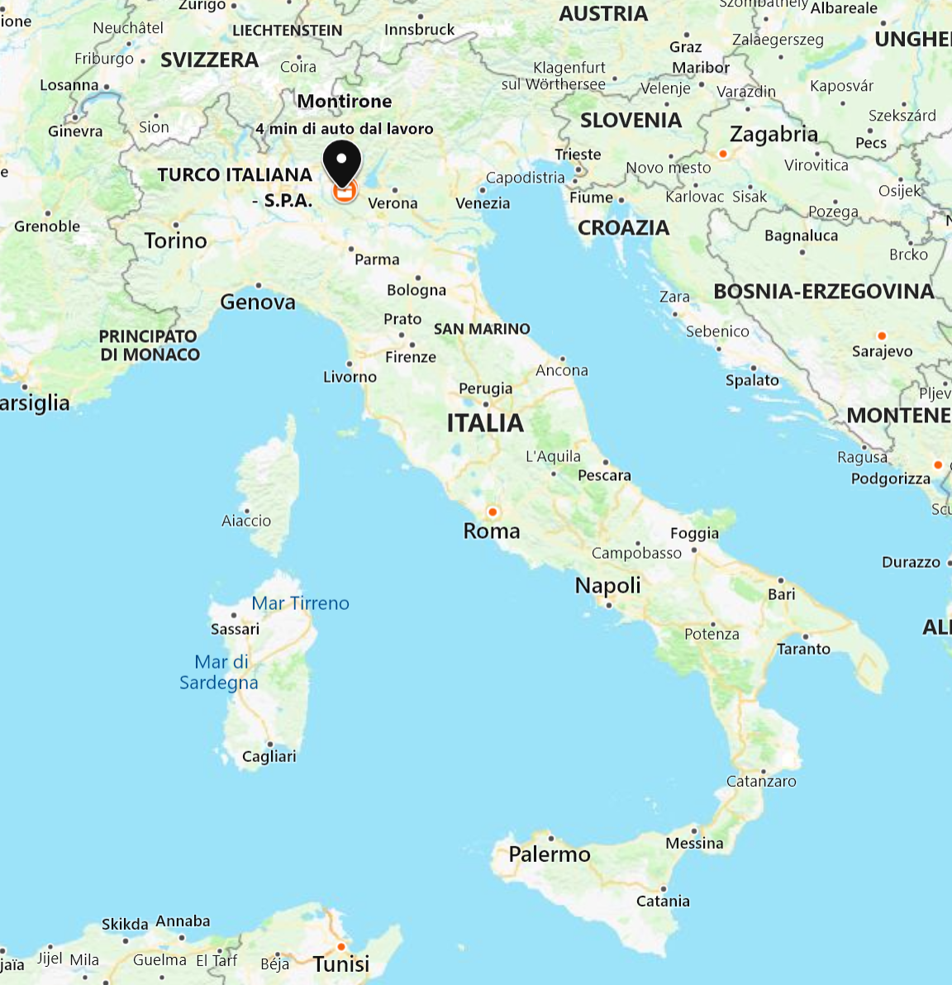
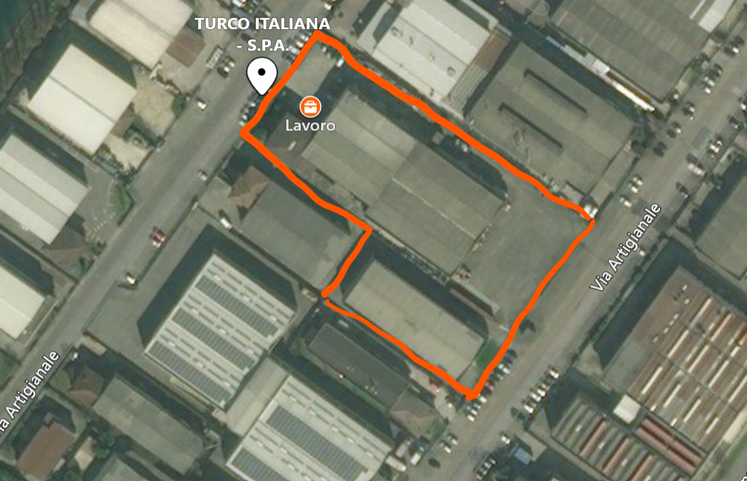
WHERE ARE WE?

Slide 5
WHAT DO WE DO?
AGENCY
Representation of companies in different geographical areas
DISTRIBUTION
Resale and stock of chemicals, seals and composite for the aerospace and high-end car markets
ADVANCED SERVICES
Stock management, Reach-connected activities (NILE)
Manufacturing capacity: up to 80 t/day

Slide 6
WHY WE DO IT?
to be
close2you

Slide 7


CERTIFICATIONS AND MEMBERSHIP
EN 9001 : 2015
EN 9120 : 2018

Slide 8



OUR ORGANIZATION

Slide 9
TURNOVER
33 employees

Slide 10














WHO

Slide 11
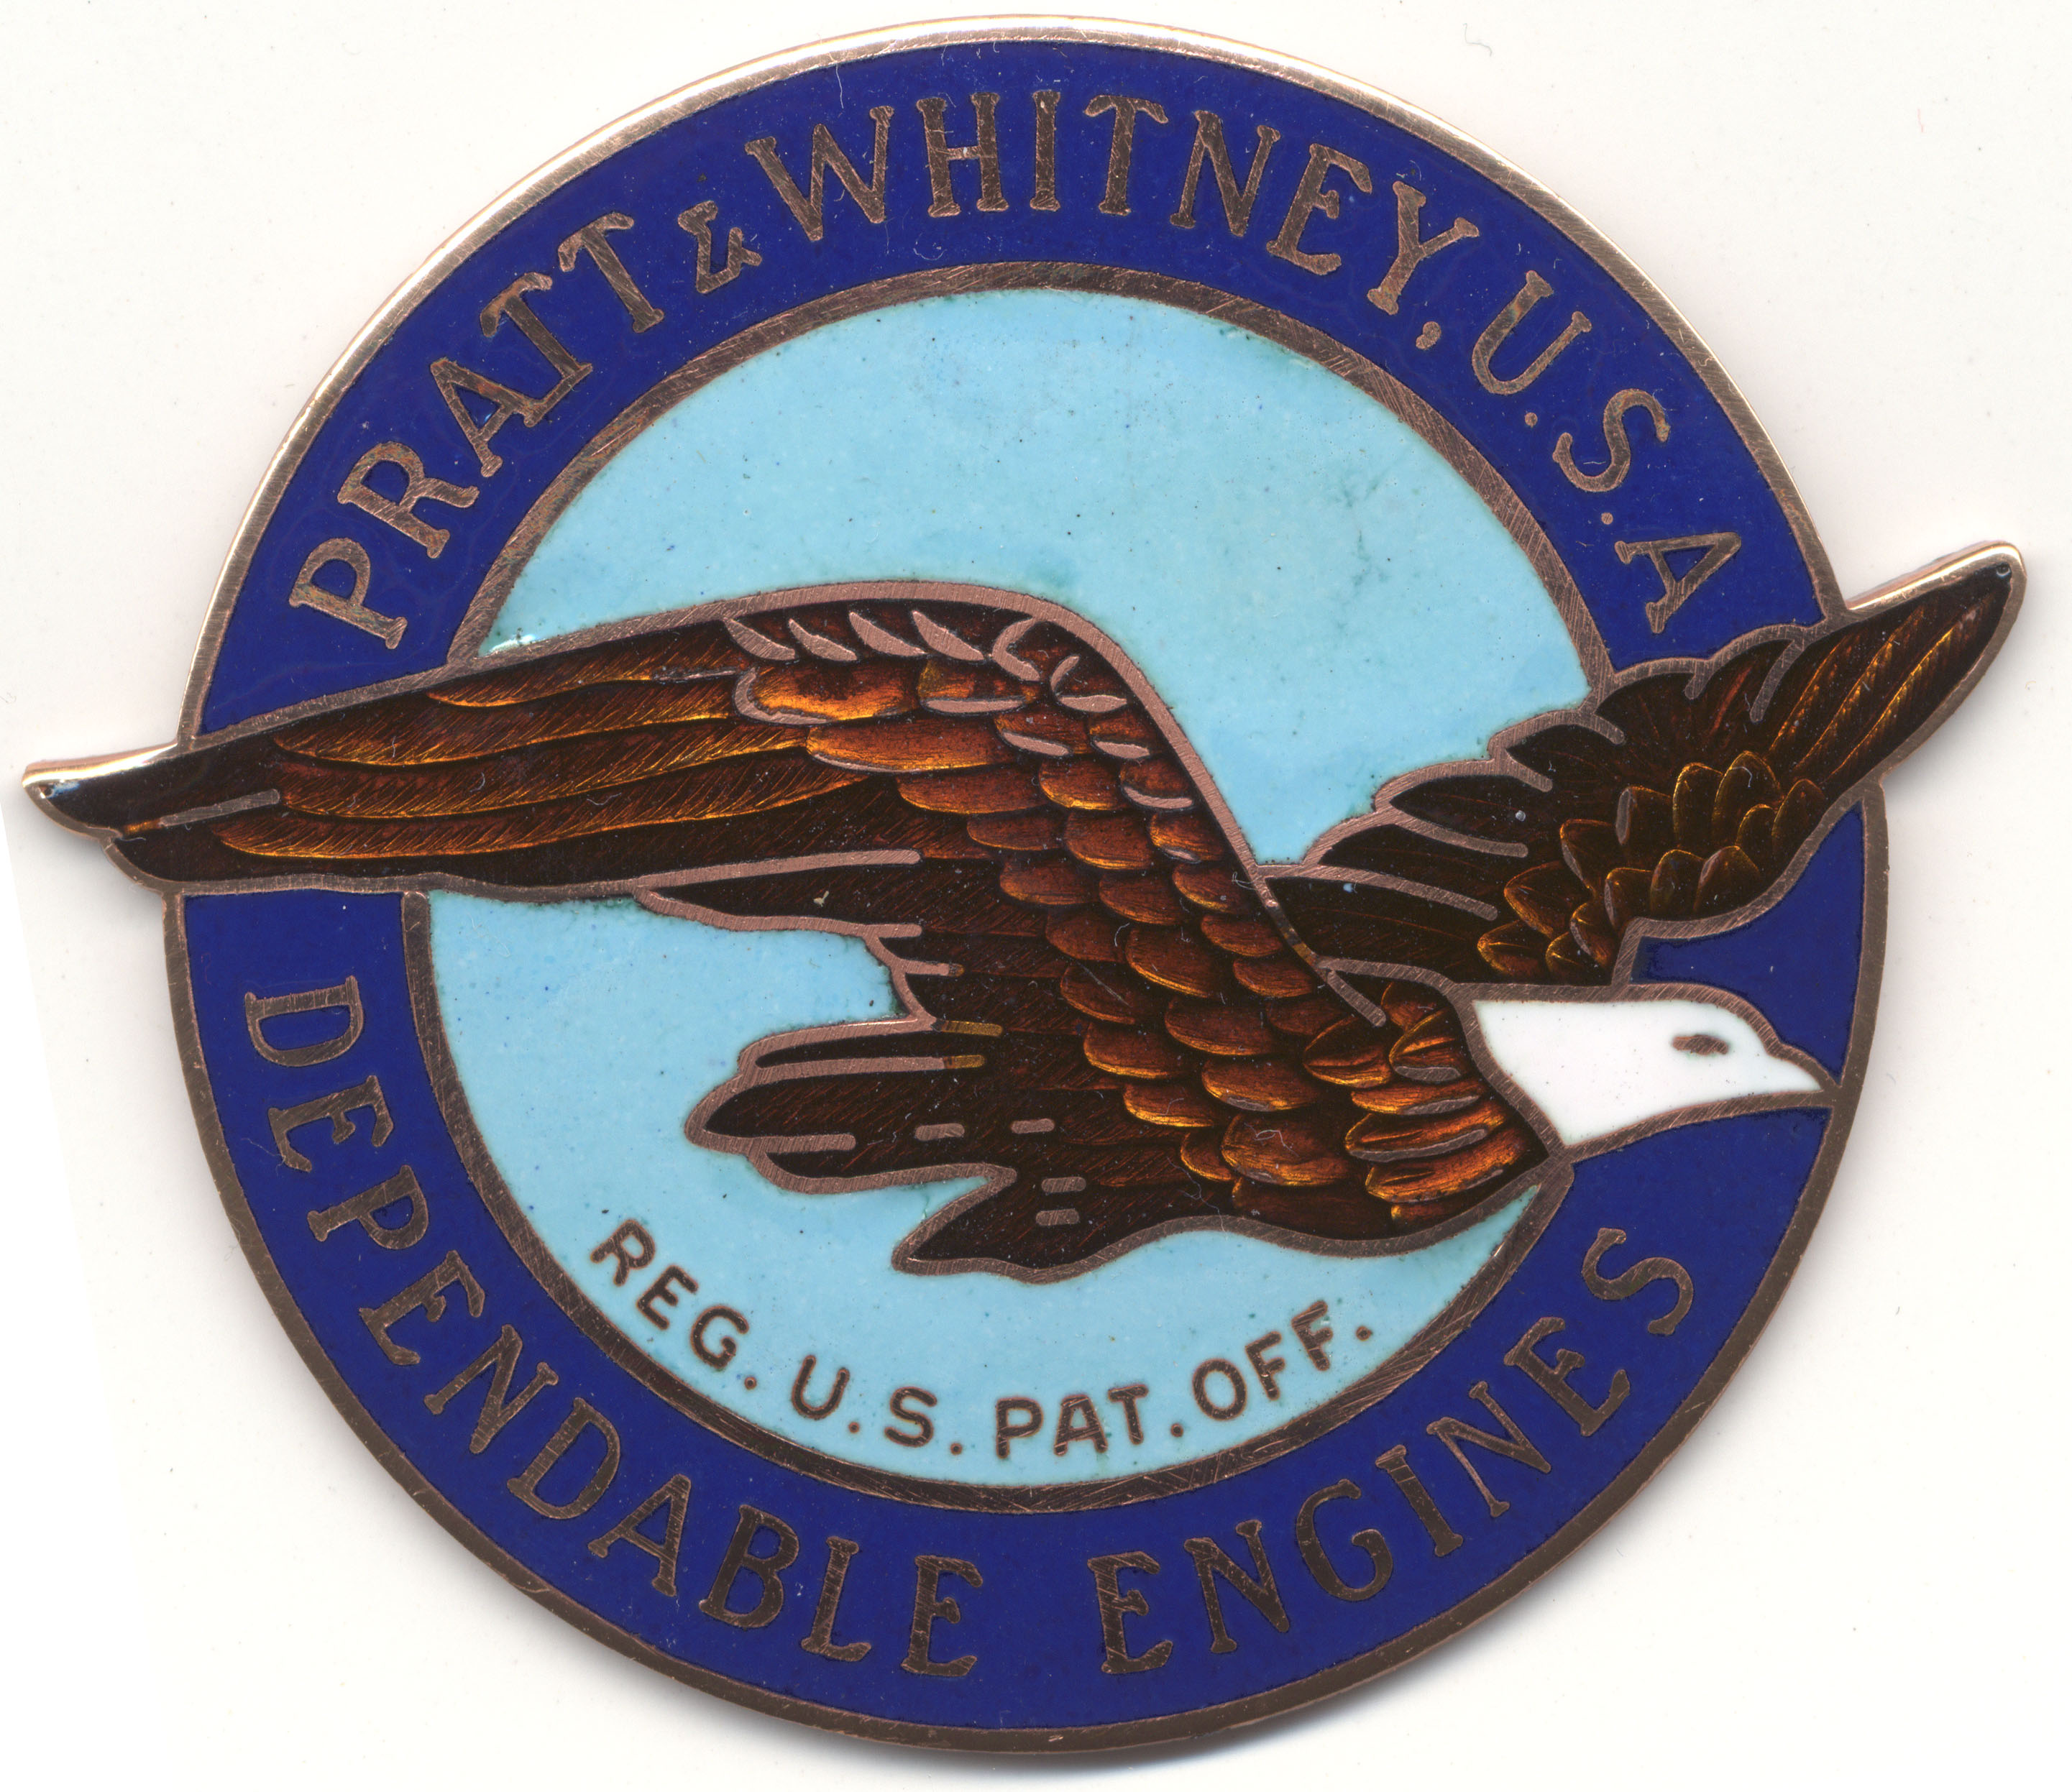

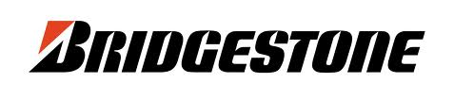


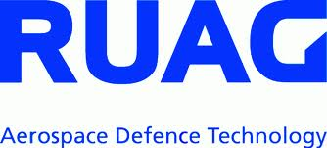














WHO

Slide 12
PRODUCTS
40+ Product groups
300+ Manufacturers
6000+ P/N (90% chemicals) 250+ turning articles in stock

Slide 13
LINE CARD
3M
ACC SILICONES
ACROS ORGANICS BVBA
ADDINOL
ADHETEC ADHESIVE SOLUTIONS
ADVANCE TAPES INTERNATIONAL LTD
AEROSHELL
AGFA
AI TECHNOLOGY, INC.
AIRTECH
AKROFIRE, INC.
AKZO NOBEL
ALCEA
ALFA AESAR
ALGLAS UK
ALPHA ADHESIVES
AMBERSIL U.K. - CRC GROUP
AMBRO-SOL
AMERICAN FIBER & FINISHING
AMERICAN GAS & CHEMICAL CO.
AMFUEL
ANDREA GALLO DI LUIGI SRL
APLIX
ARCANE INDUSTRIES
AREXONS
ARKEMA
Av-DEC
AXSON ITALIA
AZTEC CHEMICAL INC.
BASF
BEACON ADHESIVES CO.
BELLINI SYSTEMS
BERRY
BICHIMICA SRL
BIO-CIRCLE
BLUESTAR SILICONES - ELKEM SILICONES
BOLSAN COMPANY INC
BOSTIK
BP OIL
BRON AEROTECH
C. REINHOLD GMBH
CAAPCOAT INC
CALDART
CAODURO
CAPLUGS
CARLO ERBA REAGENTS
CASTROL
CASWELL
CGM CIGIEMME SPA
CHEM TREND ITALY
CHEMEON
CHEMETALL
CHEMOURS NETHERLANDS BV
CHEMTREND
CHEMTRONICS
CHIMICA CBR S.p.A.
CHIMICA DR.FR. D’AGOSTINO S.p.A.
CHOBOND
CLEAN CONSULT INTERNATIONAL
CLICK BOND Inc.
CM CHIMICA SRL
COMPOSITE MATERIALS ITALY
COMPOSITION MATERIALS CO., INC.
COOPER STANDARD
CORROSION TECHNOLOGIES
CORTEC
CR LAURENCE
CRC INDUSTRIES
DALLAS WIPING MATERIALS
DANTECANEVA SRL
DAUBERT CHEMICAL COMP. INC.
DAYTON GRANGER
DELAPENA HONING EQUIPMENT LTD
DEROYAL TEXTILES
DIAB
DIATEX
DISTRIP
DOMINO UK LTD
DOWDUPONT
DUE-CI ELECTRONIC S.R.L.
DYMAX
EASTMAN
EDDING INTERNATIONAL GMBH
ELANTAS
E-LEATHER
ELECTROLUBE
ELETTROCHIMICA VALLE STAFFORA
EMAX
ENI SPA
EPOXY TECHNOLOGY INC
ESPA
EUROCARBON
EUROCEL
EUROTROL
EVERLUBE PRODUCTS
EVONIK INDSUTRIES
EXXONMOBIL
FEDERAL MOGUL
FLAME CONTROL COATINGS LLC
FLAMEMASTER CORP.
FLUORTEN
FRIDLE GROUP - SEALING EXPERTS
FUCHS
GA.NI. SPA
GERFLOR
GLYPTAL INC.
GRACO
GREEN STAR
HANGSTERFER'S
HB FULLER
HENKEL
HENTZEN COATINGS, INC.
HERAEUS
HERESITE PROTECTIVE COATINGS
HEXCEL
HEXION INC.
HODGE (MAC ANTS ABRASIVES)
HODT KORROSIONSSCHUTZ GMBH
HOLT INTERNATIONAL
HUMISEAL
HUNTSMAN
HYLOMAR
HYPRO INDUSTRIAL
ILARIO ORMEZZANO
IMATEC
INDEPENDENT INK
INDESTRUCTIBLE PAINT LTD
INSULFAB
INTERNATIONAL PAINT LTD
INTERNATIONAL PRODUCTS CORPORATION
INTREPID COATINGS
IRPLAST S.P.A.
ISCA
ITALGESSI
ITW
JEHIER SAS
JOINTEK
JPR
KEMPER
KESTER

Slide 14
LINE CARD
KILFROST
KIMBERLY CLARK
KLEBERTEK
KLUBER
KUHMICHEL
LACKFABRIK
LAIRD TECHNOLOGIES
LAK PLASTER
LAMART CORPORATION
LAMIRSA
LANXESS SOLUTIONS
LE JOINT FRANCAIS STILLMAN
LEEPOXY
LEVOSIL
LGC STANDARDS SRL
LLEWELLYN RYNALD LTD
LOCKEREY COMP
LORD CORPORATION
LPS LABORATORIES
LUBRIPLATE
MABRA PLASTIK
MACDERMID
MADER AERO
MAGNOLIA
MANKIEWICZ
MAPAERO
MASCHINENFABRIK H. MEYER GMBH
MASK-OFF COMPANY
MAXIBLAST
MC GEAN-ROHCO
MERCK LIFE SCIENCE
MICRO MEASUREMENTS (A VPG BRAND)
MICRO SURFACE FINISHING PRODUCTS
MILLER STEPHENSON
MINKON LTD
MIRODUR S.P.A.
MKK GMBH
MOLYDAL
MOMENTIVE
MONOPOL
MORGAN ADVANCED MATERIALS/WESGO METALS
NCH
NILS
NIMAX
NITTO-DENKO
NORPLEX
NORTHWEST AERO TEXTILES
NOVAGARD
NVSC
NYCOTE LAB. CORP.
ORAPI
ORCON
ORSA FOAM SPA
PALINI VERNICI
PANACOL ELOSON GMBH
PARAGON SCIENTIFIC LTD
PARKER
PELSEAL
PERKIN ELMER
PERMABOND
PETROFERM CLEANING PRODUCTS
PLUSTAR INC
POTTERS BALLOTINI SAS
PPG
PPG SEMCO
PRAXAIR SURFACE TECHNOLOGIES
PRECISION FABRICS GROUP (PFG)
PRIST AEROSPACE PRODUCTS
PROCHIMA
PROPAGROUP SPA
PSA PRODUITS SANITAIRES AERONEFS
RANDOLPH
REAGECON DIAGNOSTICS
RHENUS
ROBNOR RESINLAB LTD
ROCOL
ROULUNDS BRAKING APS
ROYAL ADHESIVES & SEALANTS
RPM TECHNOLOGY
RS PRO
SAFRAN AEROSYSTEMS
SAINT GOBAIN
SAINT GOBAIN ABRASIVES
SANFORD, L.P.
SARATOGA
SCHAEFER MACHINE COMPANY
SCHUELKE & MAYR GMBH
SEKO
SHERMAN CHEMICALS UK
SHERWIN INC
SHERWIN WILLIAMS
SIFCO ASC
SIKA
SIMCO COATINGS INC
SKYDROL
SOCOMORE
SOLIANI EMC SRL
SOLVAY
SOLVENT KLEENE
SPECIAL TOOLS
SREM TECHNOLOGIES
STABOND
STAUB & CO. - SILBERMANN GMBH
STONER INC.
STRUCTIL
SULZER METCO
SULZER MIXPAC
SUMITOMO BAKELITE NORTH AMERICA, INC.
SWAGELOK
TECHCON
TECHSPRAY
TEEPOL
TESA
TEXTECH
THETFORD
TIODIZE
TOTAL
TQC
TRANSENE COMPANY, INC.
TRIMITE
TRISTAR COATINGS
TRI-TECH METALS
TUFNOL COMPOSITES
TURCO ITALIANA SPA
TYCO ELECTRONICS
UHU BOSTIK SPA
ULTRACHEM
VALVOLINE
VANTAGE
VELCRO
WACKER CHEMIE AG
WD COMPANY
WEICON
WHITFORD
WULFMEYER
ZEP
ZF LUFTFAHRTECHNIK GMBH
ZIPCHEM
ZODIAC AEROSPACE
ZOTEFOAMS

Slide 15











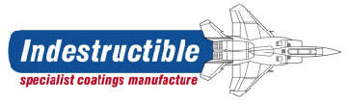




























Maxi-Blast®
AND MANY MORE…

Slide 16
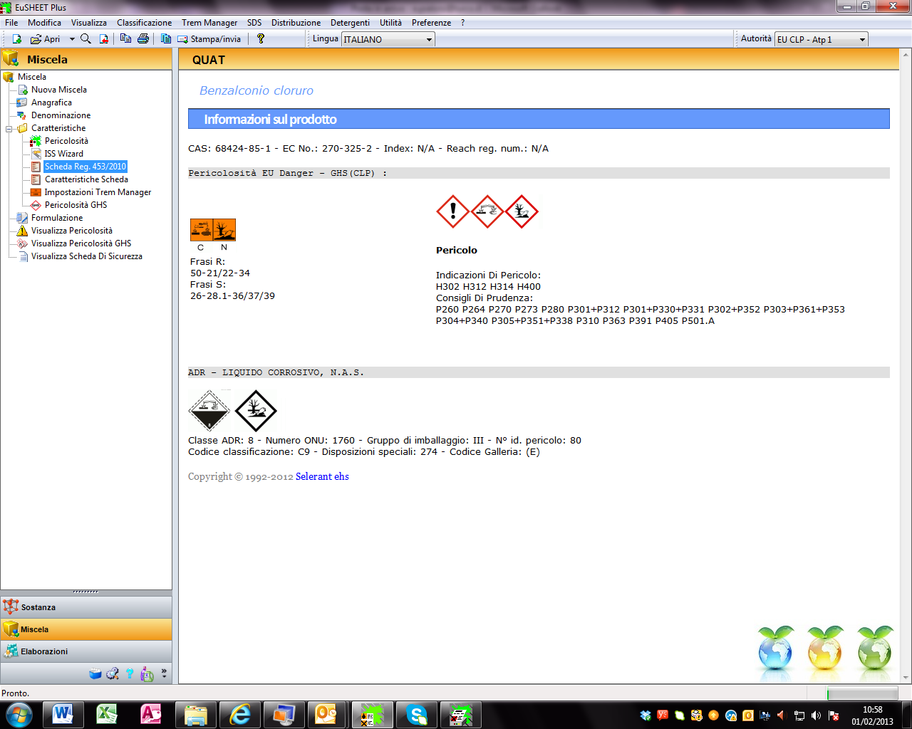
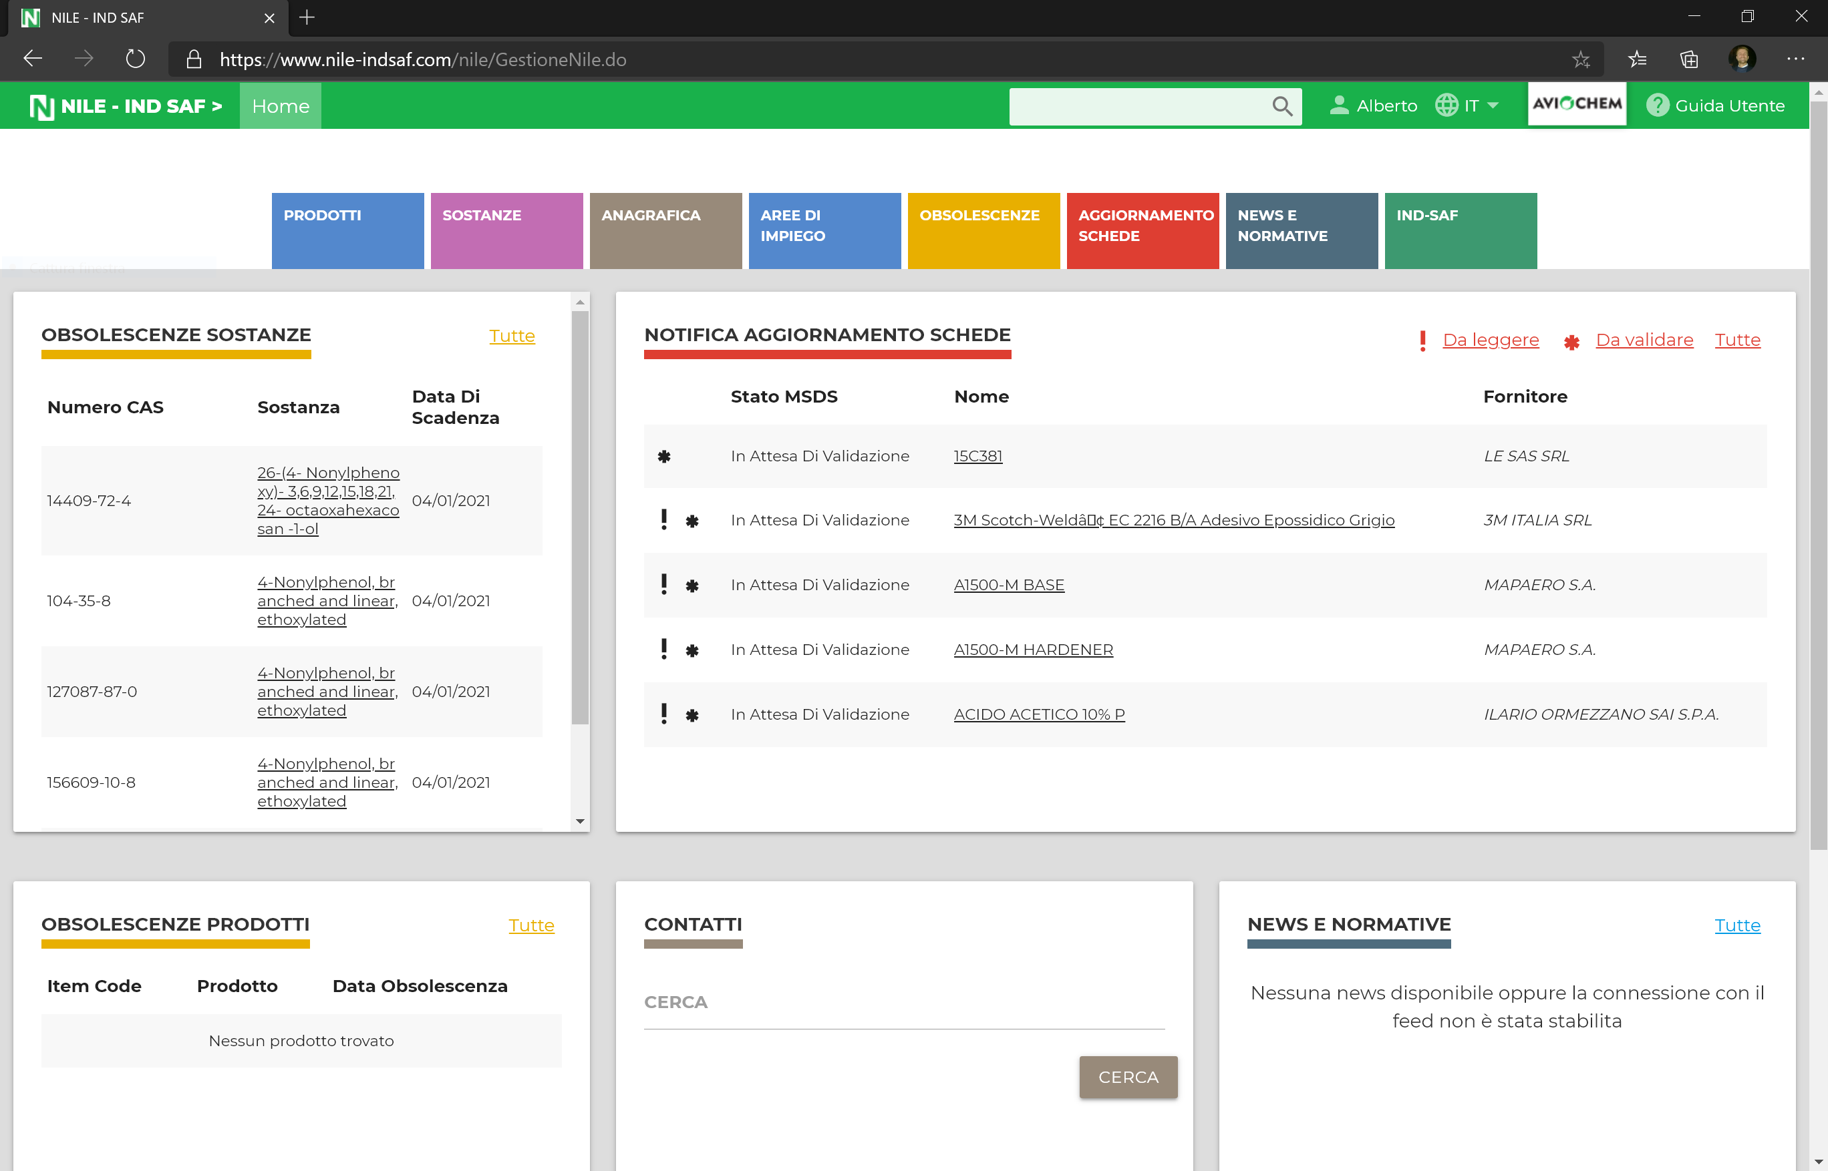
SERVICES
Consolidated purchasing
Stock management
MSDS – CLP/GHS –REACH services
NILE: chemical documents made simple

Slide 17
THANK YOU !

